Slide 1

Portfolio Performance Overview
Last updated on the 16 November 2025 at 04:32 PM

Slide 2
Trade Plan and Brokerage Overview
Total Portfolio: $52,308.29 (-127.04) Total Brokerage: $220.00 Net Invested: $52,528.29 (-116.04)
Security | Current | Target | Change | Last Price | Brokerage | Cash Flow
A200 | 17 | 24 | 7 | $144.56 | $11.00 | -$1,022.92
ACDC | 16 | 18 | 2 | $136.23 | $0.00 | -$272.46
AT1 | 20334 | 19707 | -627 | $0.03 | $11.00 | $7.18
BHP | 66 | 5 | -61 | $42.75 | $11.00 | $2,596.75
BLOK | 3 | 22 | 19 | $91.44 | $0.00 | -$1,737.30
ETHI | 144 | 265 | 121 | $16.50 | $11.00 | -$2,007.50
FMG | 149 | 0 | -149 | $20.23 | $11.00 | $3,003.27
GME | 0 | 12 | 12 | $31.60 | $0.00 | -$379.14
LKE | 65482 | 0 | -65482 | $0.06 | $11.00 | $3,721.47
MQG | 12 | 0 | -12 | $200.58 | $11.00 | $2,395.96
MTUM | 80 | 61 | -19 | $29.19 | $11.00 | $543.61
NDQ | 38 | 66 | 28 | $56.24 | $11.00 | -$1,585.72
Security | Current | Target | Change | Last Price | Brokerage | Cash Flow
PNV | 1563 | 167 | -1396 | $1.16 | $11.00 | $1,615.34
QLTY | 72 | 125 | 53 | $33.06 | $11.00 | -$1,763.18
QUAL | 40 | 56 | 16 | $61.43 | $11.00 | -$993.88
SMH | 2 | 1 | -1 | $527.58 | $0.00 | $527.58
SMLL | 477 | 946 | 469 | $4.62 | $11.00 | -$2,177.78
VDHG | 34 | 63 | 29 | $73.53 | $11.00 | -$2,143.37
VLUE | 75 | 133 | 58 | $32.90 | $11.00 | -$1,919.20
VMIN | 42 | 50 | 8 | $63.04 | $11.00 | -$515.32
VSO | 30 | 65 | 35 | $76.44 | $11.00 | -$2,686.40
VVLU | 31 | 41 | 10 | $78.55 | $11.00 | -$796.50
WDS | 125 | 0 | -125 | $26.24 | $11.00 | $3,269.00
YMAX | 373 | 74 | -299 | $7.45 | $11.00 | $2,216.55

Slide 3
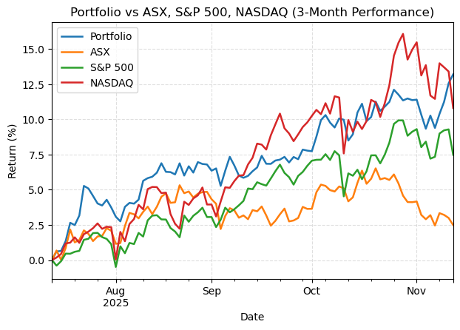
Portfolio Performance

